Slide 1
Testing Strategies for Robust and Reliable React Applications
@TheKrPrince

Slide 2

Developers feeling happy after writing code
@TheKrPrince

Slide 3

Panicking when feature breaks in production
@TheKrPrince

Slide 4
So why should we write tests?
Allows to catch bugs very easily during the development process.
Increases the confidence in the application.
Speeds up the QA time.
Works like a documentation.

Slide 5
Different types of Tests for developers:
Unit - focus on testing individual units of code in isolation, such as React components or utility functions. They verify that each unit behaves correctly and produces the expected output for a given input.
Integration - Most likely your React app is going to interact with multiple components and through the integration tests we tests how are these components working together and are they working properly?
End-to-End (E2E) - Usually a multi step test combining multiple unit and integration tests into one big test. Usually very little is mocked or stubbed. Tests are done in a simulated browser, there may or may not be a UI while the test is running. example: testing an entire authentication flow.
@TheKrPrince

Slide 6
Test Block
Render a component we want to Test
Find elements we want to interact with
Interact with those elements
Assert that the results are as expected

Slide 7
Tools to Test React Applications
React Testing Library (RTL)
https://testing-library.com/docs/react-testing-library/intro/
Jest
https://jestjs.io/docs/getting-started
@TheKrPrince

Slide 8
Unit Testing in React
Unit tests for React components involve verifying their rendering output, handling of props and state, event handling, and any business logic contained within the component. Testing utility functions ensures they perform their intended tasks correctly and return expected results.
@TheKrPrince

Slide 9
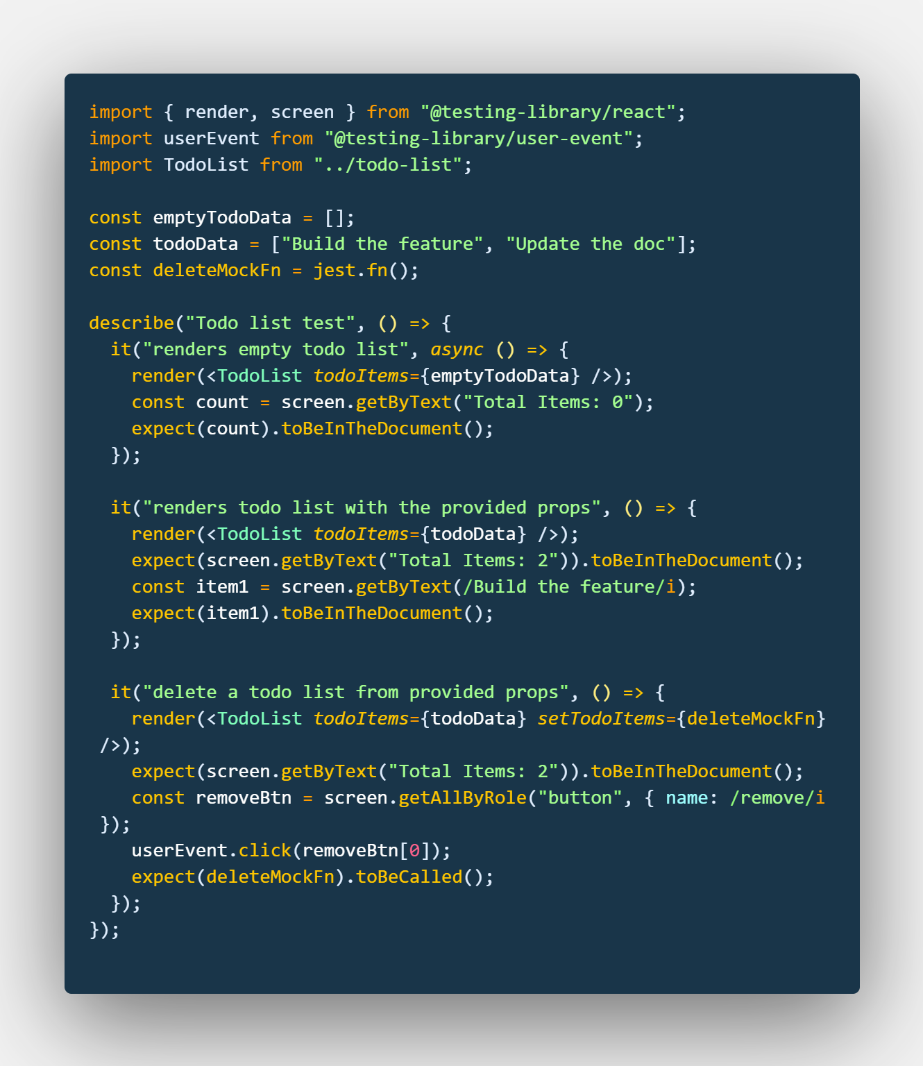
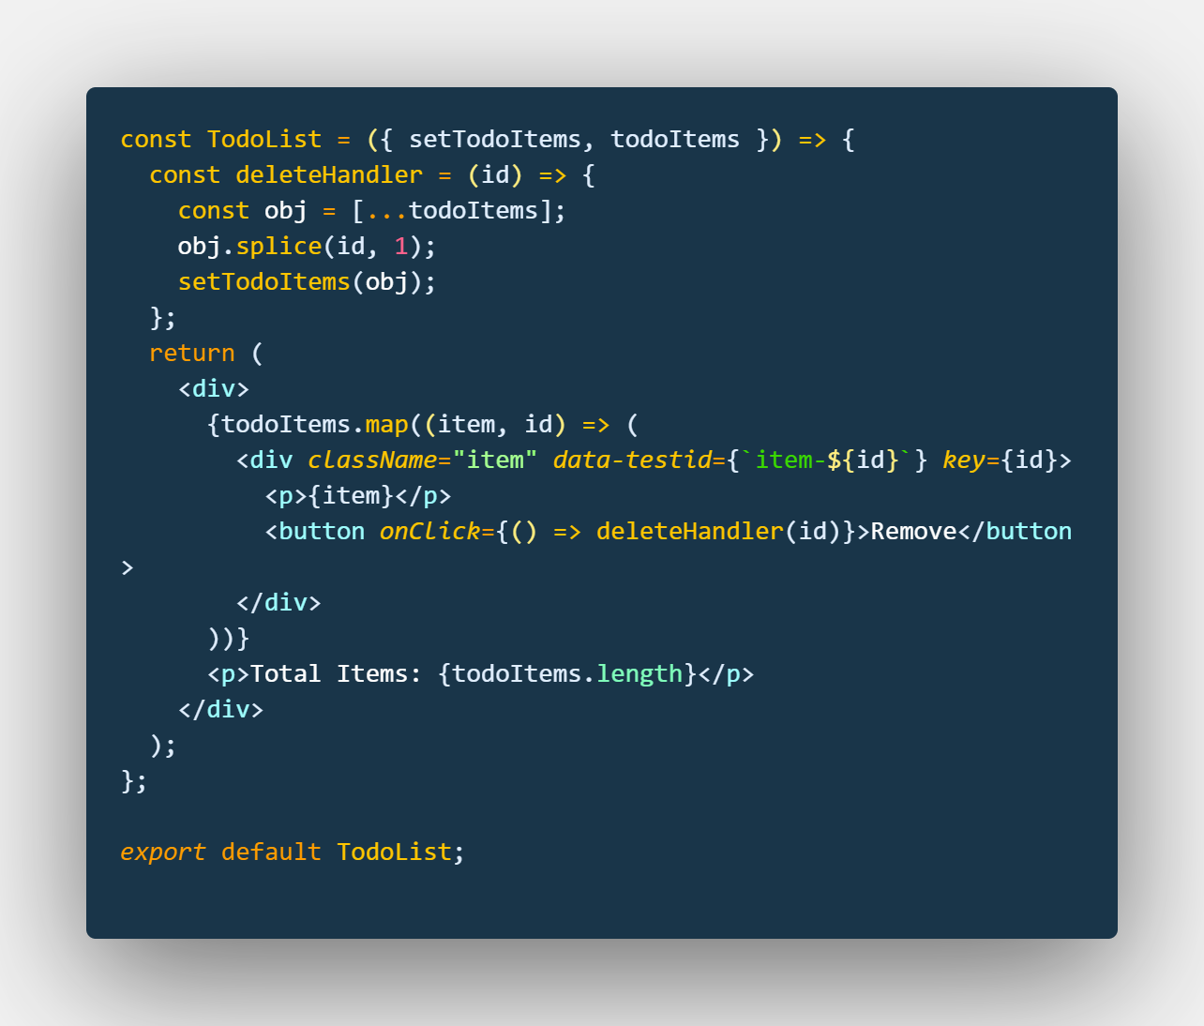
@TheKrPrince

Slide 10
Integration Testing
Integration testing ensures that different units of code work together seamlessly and interact correctly. It focuses on testing the integration and data flow between components.
Integration tests may include mounting multiple components together and testing their behavior as a unified system.
@TheKrPrince

Slide 11
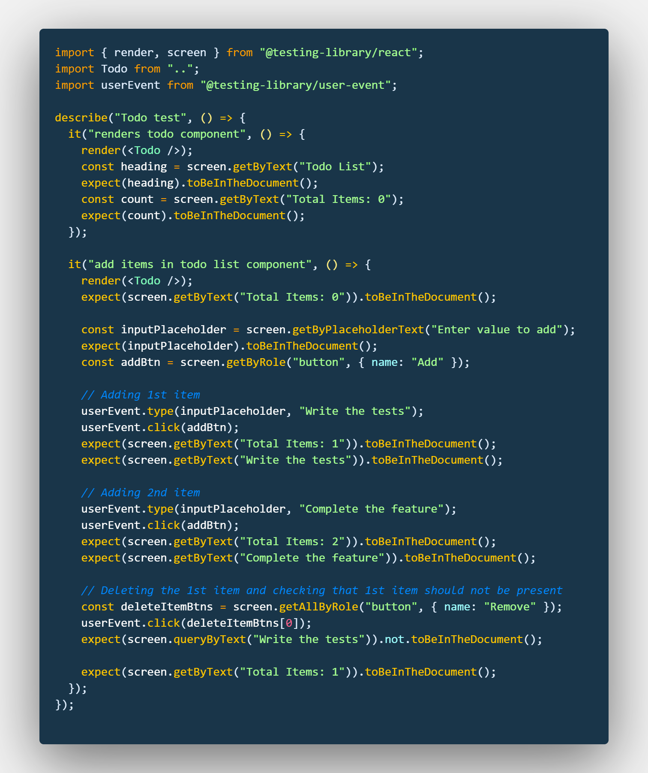
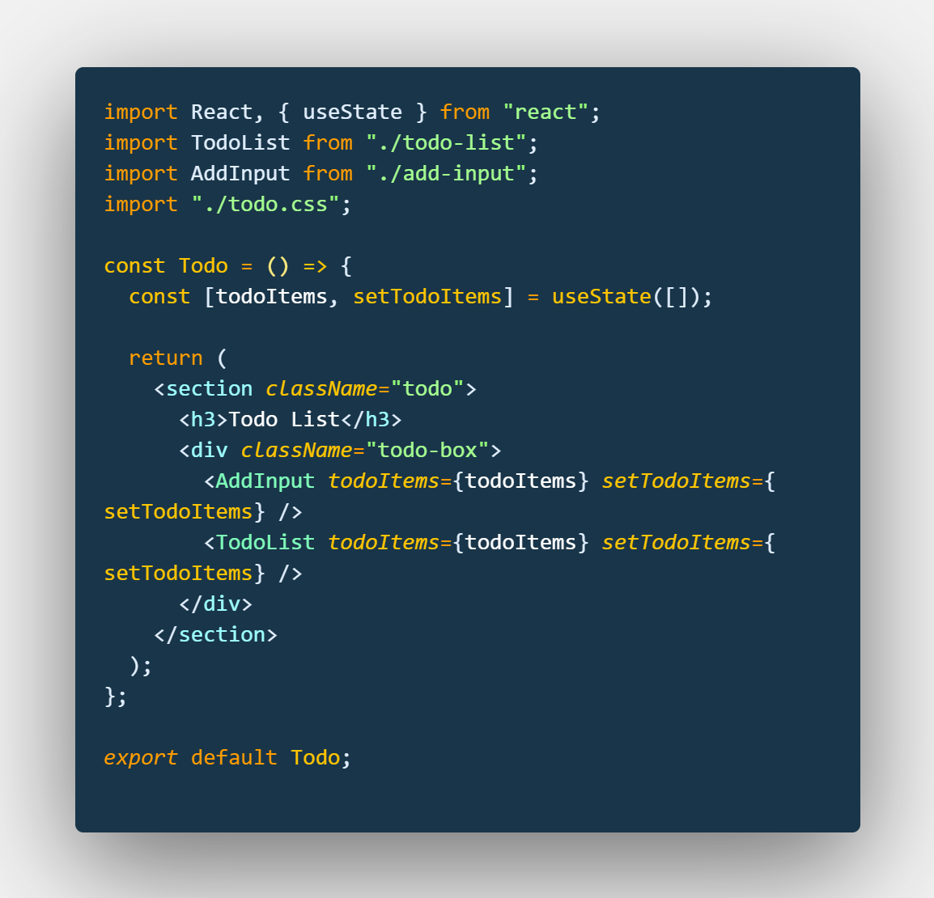
@TheKrPrince

Slide 12
Tips for testing asynchronous code and API interactions in React:
React applications frequently involve asynchronous operations, such as API requests. Testing asynchronous code requires handling promises, timeouts, and mock server responses effectively.
Techniques like using async/await, mocking API requests, and simulating async behavior can help ensure accurate testing of asynchronous code.
@TheKrPrince

Slide 13
Strategies to Test React app state and state management libraries
React applications often rely on state management libraries like Redux or MobX. Testing state-related functionality involves ensuring that state changes are handled correctly, actions and reducers produce the expected results, and components react appropriately to state updates.
Mocking store dependencies and testing state management interactions are essential for comprehensive testing.
@TheKrPrince

Slide 14
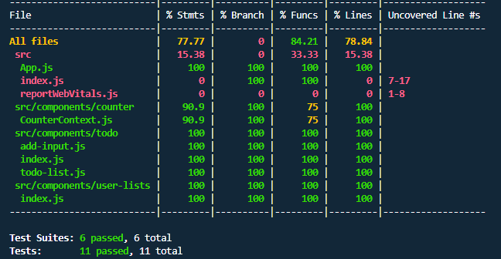
Test coverage and code quality metrics
Test coverage is a metric that can help in understanding how much of the software code is tested.
@TheKrPrince

Slide 15
Building end-to-end tests for full user flow coverage in React applications
End-to-end tests simulate real user interactions and cover the entire application flow, from initial page load to user input and data submission. They are typically automated tests that traverse the application, interacting with UI elements, making assertions, and validating expected outcomes.
Tools like Cypress or Selenium can be used for creating end-to-end tests in React applications.
@TheKrPrince

Slide 16
Learn more
https://testing-library.com/
Freecodecamp
YT Lecture1
YT Lecture2

Slide 17
Thank you!
I’m Prince. SDE3 @ Walmart
Say Hi👋on Twitter: @TheKrPrince

